Slide 1
Welcome to Week 6
Data Cleaning using Python

Slide 2
The 5 Core Components
Exploratory
Analysis
Feature
Engineering
Model
Training
Data
Cleaning
Algorithm
Selection

Slide 3
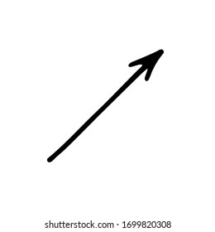
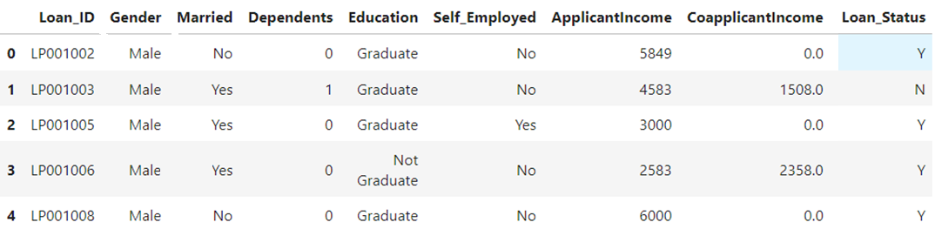
Data Set
Variables, attributes, features, fields, columns, dimensions, indicators, predictors, dependent variables, response variables
Rows, observations, instances, data point, use cases, items, samples
Notes:
Contextual Clarity - target variable, attribute in database, Interdisciplinary Overlaps

Slide 4
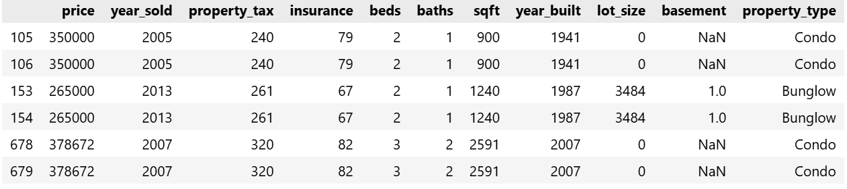
Removing Duplicate rows (use cases)
First thing to remove duplicate rows:

Slide 5
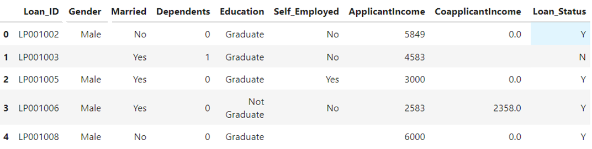
Data Cleaning
Missing
value
Missing
value
Missing
value
Notes:
Variables, features,

Slide 6
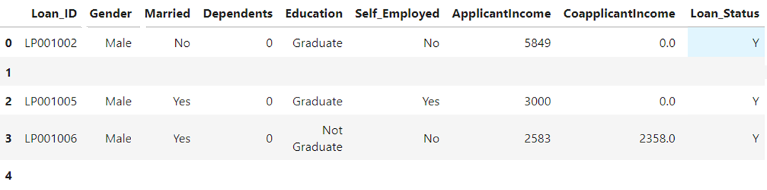
Data Cleaning
Missing
Use case
Missing
Use case
Notes:
Variables, features,

Slide 7
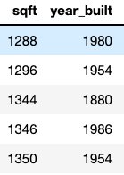
Outliers
Outliers are innocent until proven guilty!
Good reasons to remove outliers:
Suspicious Measurements
A house built in year 1880 (when all others are after 1900).

Slide 8
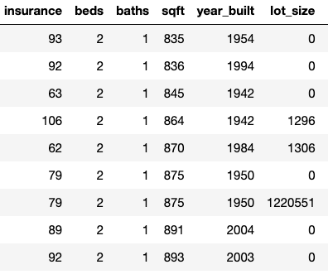
Outliers
Good reasons to remove outliers:
2. Different Population
A home with a lot size over 1,000,000 sqft (when all others have lots under 500,000 sqft).

Slide 9
Missing Data
Some algorithms simple don’t accept missing values.
The two most recommended ways to deal with missing data are:
Option 1: Drop missing values
Option 2: Impute Missing values

Slide 10
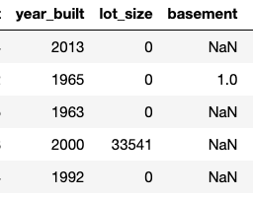
Missing Data
Option 1: Drop missing values
When you remove observations, you also remove some information. The fact that the piece of data is missing could be an information itself.

Slide 11
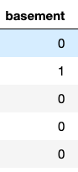
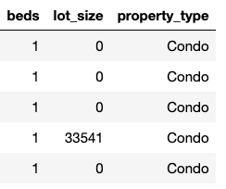
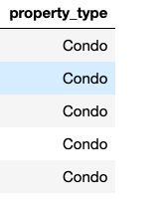

Missing Data
Option 2: Impute Missing values
No matter how sophisticated your imputation is, you're not adding any real information
Based on condition or frequent class

Slide 12
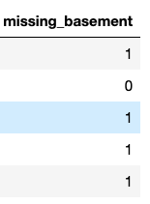
Missing Data
Option 3: Label Missing Values
Numeric Features: Flag and Fill
Create indicator variable to flag missing values
Fill the original variable with any consistent placeholder

Slide 13
Notebook Activities
Drop unwanted observations
Handle Missing Data
Remove ‘Guilty’ Outliers
Better Data beats Fancier Algorithm

Slide 14
Open Notebook Data_Cleaning.ipynb

Slide 15
Thank you!

